Slide 1
Customer Data Discovery
Customer Experience Products
July 13th, 2020
v3

Slide 2
Agenda – Customer Experience Products
Introduction & Objectives – engagement purpose (as-is & to-be data capability assessment, data roadmap and investment sizing)
Confirm Customer Experience Products Scope & Capabilities – process-centric summarization & platform leverage
End-To-End Data Flows – provide high-level input into upstream, real-time and downstream as-is data domains and pain points
Discuss Future-State Customer “Golden Record” Perspectives – drivers of future customer data model from Customer Experience Products vantage point
5 mins
10 mins
30 mins
20 mins

Slide 3
CXP Scope (defined by inflight technology changes)
For Discussion
Web
Preference Center
IVR
Personalization Tool
(ownership to Digital Delivery)
[in flight] Unified Web – replacement of Web Self Service (portal, identity and access mgmt) merging the CSS and CRIS transactional portals)
[future state] Going-forward foundation is Communities and Azure B2C IAM
(ownership/support model tbd?)
[in flight] Foundation is being centralized within Salesforce (Service Cloud, Marketing Cloud) using defined patterns
Support GBE on appointment time reminders
Some marketing communications (i.e, promote EasyBill programs) – track clicks and opens
(ownership to Contact Center)
[in deployment] AIMS – new environment, 21st Century for outage. As-is and to-be architectures defined.
[new] automated customer services (agent services): Omni- channel, BOTS, agent enablement (discuss on Monday). Fundamental issue – 15 apps agent has to manage across
[needed]WFM – call analytics, feed into customer experience
[in flight] Integration moving from from OFM to Mulesoft
(ownership to Contact Center)
[deployed] Next best action, predictive intent. Started with Low to Moderate income in RI – analytics to address (ex. high-bill, eligibility for state/NG support). Why calling?, what can be offered?
[in flight] Extended to complaints, call types, service issues, other segments, jurisdictions (EnergySavvy -> Uplight – SERVICE).
[future] Interim solution until CRM built-in via Einstein, etc. Analyticswill run off of data hub
Customer data model – persistent customer
Account claim process – GridForce upstream vs. IAM & Preference Center downstream
Notes:
Don’t do it just because there is a deadline.

Slide 4
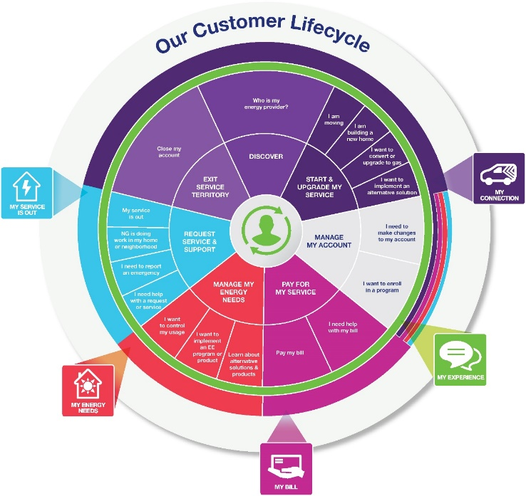
CXP – apps deployment to systems of engagement?
For Discussion
Product/Service Lifecycle
Start My Service (content web, transaction web, application portals, SoRs)
Manage My Account (content web, transaction web, app portals, SoRs)
Pay My Bill (?)
Manage My Energy Needs (personalization tool)
Request Service & Support (content web, transaction web, app portals, SoRs)
Prospect?
Acquire?
Service?
Inbound CSR Scope
Outbound Follow-On CSR Scope
Notes:
Don’t do it just because there is a deadline.

Slide 5


Information Flow Analysis – where does CXP play?
Products/
Services
Contact /
Customer
Profile /
Preferences
Lead /
Opportunity
Location
(Premise)
Case
(e.g. Application/
Work Order
Complaint)
Customer
/ Account
Asset
(e.g. Meter /
Product
Thermostat)
Usage
(Meter
Reading)
Bill /
Payment
GL
Account
Data Domain
Market / Sales
Market / Sales
Market / Sales
Service
Service
3
Service
Asset
Asset
Bill/Pay
Finance
Need to align with Electric and Gas Ops Flows
Need to align with Electric and Gas Ops Flows
CSS Transaction Web
1
CRIS Transaction Web
Need to end to end process for Lead/Opportunity for all products
Application Portal (DG/Electric)
Need to add metering systems for input into CIS systems
Marketplaces (EE/EV Products)
2a
Need details Marketplace - Reimbursements for LC&I, Small Business and Trade Partners via DSM. Manual and Automated Flows
Questline / MC (Marketing Comm)
2b
Kubra (Outage Comms)
email
Right Now
CRM Sales (Grid Force)
In-Demand (DSM/EE Program Mgt.)
Applications
CRIS (Gas –NYC,MA)
CSS (Gas, Elec, DG)–UNY,MA,RI,LI)
CRM Service (GBE-RI)
MITS (CSS) / SPIPE / DIS (CRIS)
GIS
Maximo / MDSI
Need to find more details about CRIS GIS Feed
Storms / Mwork / MDSI (LI)
OMS (Outage)
SAP ECC6
CEMP 3rd Party (Uplight / O-Power)
4
CIAP
Customer
Data Platforms
ADA
CDI
CCAE
CSS (Revenue) Data Warehouse
CSQ / Trends
Automated API
Automated Replication
Single data master agreed
No Explicit Master / Implied
Data mastered in multiple applications
(This includes across all Jurisdictions)
DB Link
Manual replication
Notes:
Don’t do it just because there is a deadline.

Slide 6
Data Flows
Live Discussion
Customer Experience Products – Web & Preference Center
Pain Points
Upstream Data
Transactional Data
Downstream Data
Customer Data Model
Account Claiming Process
Notes:
Don’t do it just because there is a deadline.

Slide 7
Data Flows
Live Discussion
Customer Experience Products – IVR
Pain Points
Upstream Data
Transactional Data
Downstream Data
Customer Data Model
Notes:
Don’t do it just because there is a deadline.

Slide 8
Data Flows
Live Discussion
Customer Experience Products – Personalization Tool
Pain Points
Upstream Data
Transactional Data
Downstream Data
Customer Data Model
Notes:
Don’t do it just because there is a deadline.

Slide 9
Appendix

Slide 10
IAM and Acct Claiming – in flight and to-be
Web
Preference Center
Account claiming process: get identity, then claim accounts by proving authorization to transact – creates grouping but not through customer path. One-sided view (customer) – not exposed to NG or NG customer data model. CC can see what accounts have been claimed, just not viewed through profile. Web profile is extended within CSS and CRIS data model. But Web Account vs. Account not tied to customer. Separate channel for user authorization to transact through account. This is in MyAccount model and CRM. Soon to be in CRM Service only. Authorized User in CSS (not in CRIS). Lacking MDM for customer, authorized user, web user. Working around this until get MDM. Validation – CRIS now through what you know / access code. CSS through you know about account. Future – based on identity/preference – account holder must approve

Slide 11
CXP vs. Customer Data Domain (Data Foundation)
CXP funding / staging:
- CXP roadmap
- additional $ for communities to come
- once to unified web, need the enablers across the balance of features roadmap based on CXP – resequencing from a web/preference but in backlog
- also need to add in enabling capabilities, including data – some incremental, some net new
Data Foundation assessment:
- dependencies on data enablers are part of this assessment to support the blueprint roadmap (big rocks)
- customer data model is core
- data cleansing tools
- MDM tool
- global DL/DM and reporting
- data architecture
- data governance
(all placeholders – data foundations)
Address Data as MVP
Transactional-level data cleansing and conversion
Platform data architecture
Use services
MDM for legacy in interim state (CSS, CRIS) – for master data
MDM to new CIS in future state
Change data capture in back-end systems into CRMs (persistent issue in current environment (CSS, CRIS) and in future environments (SAP as CIS))

Slide 12
AMI Program (+1 channel for Customer Energy Mgmt Self Service)
Within business case
Comparative analysis
Custom analyses (self service)
Opower – today
Customer Energy Mgmt
AMI Data
Load disaggregation model
Data back into broader intelligence and personalization, next-best-action
Data sharing – Green Button, Green Button Connect, EE Data sharing
Timing for AMI – in roadmap assumptions – CIS, AMI, Foundational CXP, incremental functionality
Sequencing and dependencies known

